Slide 1



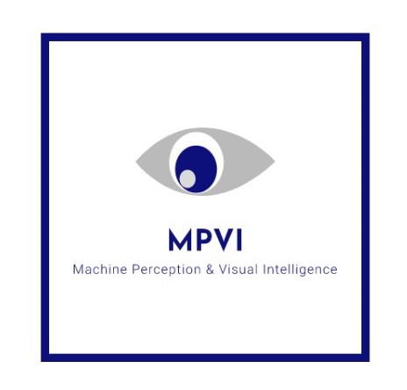

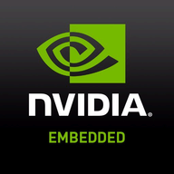
SURVEILIA
SPONSORED BY
Machine Perception & Visual Intelligence Research Group

Slide 2
PURPOSE AND PROBLEM
Increased crime rate with growing population. Even with CCTVs, large number of events go undetected/delayed-reporting
Even with proper monitoring , crimes remains undetected simply due to human error
Over 400,000 crimes reported in Punjab in 10 months (Jan 2020- Nov 2020).
Traditional CCTV setup requires constant monitoring, or large human resource base for CCTV clusters
# 1
# 3
# 2
# 4
Machine Perception & Visual Intelligence Research Group

Slide 3
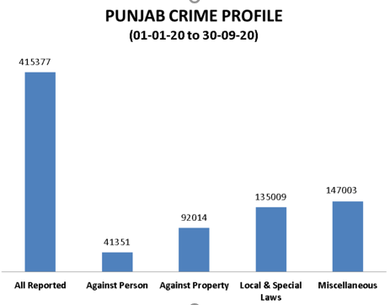
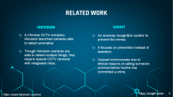
PURPOSE AND PROBLEM
Crimes reported in Punjab circa 2019-2020 https://punjabpolice.gov.pk/crimestatistics
Machine Perception & Visual Intelligence Research Group

Slide 4
RELATED WORK
HIKVISION
AISIGHT
A Chinese CCTV company, Hikvision launched cameras able to detect anomalies
Though Hikvision cameras are able to detect multiple things, they require special CCTV cameras with integrated chips.
An anomaly recognition system to prevent the crimes.
It focuses on prevention instead of detection.
Caused controversies due to ethical reasons of calling someone criminal before he/she has committed a crime.
https://www.hikvision.com/en/
https://aisight.de/en
Notes:
such as unattended baggage at crowded scenes, do facial and license plate recognition.
They worked with Movidius [4] to create cameras with integrated chips to be able to run deep neural networks right on board.

Slide 5
01
02
Real-time detection of anomalous/suspicious human activities over live CCTV/ IP Camera input feed using deep learning approach.
03
Our Solution: SURVEILIA
Automates and facilitates intensive Surveillance work-load for single to multiple camera streams (up to 6 simultaneously)
Embedded AI on the Edge, with Inference Engine, core application deployed on NVIDIA’s Jetson Nano I-GPU powered Platform
Machine Perception & Visual Intelligence Research Group

Slide 6
FLOW OF SURVEILIA
Applies data preprocessing and feeds frames to inference engine.
Detects and extracts key-event anomaly snippets.
Preprocessing
Anomaly Detection
1
2
3
4
5
Camera OR Footage
Inferencing Model
User Alert
Feeds live video stream or CCTV footage to the system or to NVIDIA Jetson Nano.
Frames are fed to the Trained TSM based Inference Engine to obtain probability outputs/results.
Instant notification.
Machine Perception & Visual Intelligence Research Group

Slide 7
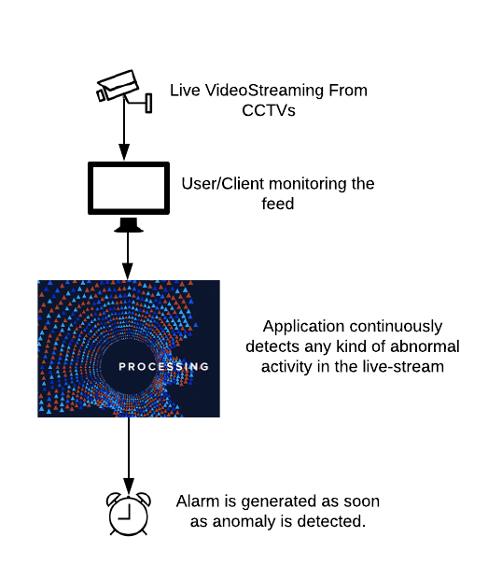
GRAPHICAL REPRESENTATION OF SURVEILIA
Machine Perception & Visual Intelligence Research Group

Slide 8
FEATURES
USABILITY
FUNCTIONALITY
PORTABILITY
FLEXIBILITY
Easy and simple to use. Works on any system installed at the security office.
Works on CCTV Footage, CCTV Live Stream(IP Camera), Webcam.
Deployed and works on Linux, Windows and NVIDIA Jetson Nano.
Ability to adapt to possible or future changes in its requirements
Machine Perception & Visual Intelligence Research Group

Slide 9
Dataset Preprocessing
Model architecture selection and training with the desired dataset.
Researching implementable solution in context of low resource consumption.
Solution of the model based on memory-footprint requirements and inference accuracy
Learning our Tool-stack, Pytorch, OpenCV, NumPy, PyQt5, SQLite3.
TASKS
Inference on test dataset, retraining and hyper-parameters fine-tuning based on performance analysis (In Progress).
Generating the anomalous snippets.
Configuring application for real-time inference for simple system and NVIDIA’s proprietary tool chain.
Application testing.
Development of the Python based UI using PyQt5 and its tools and integrating it with the model to inference on both, the system and NVIDIA Jetson Nano.
Machine Perception & Visual Intelligence Research Group

Slide 10
CORE SYSTEM MODULES
INFERENCE ENGINE
PYTHON UI
NVIDIA Jetson Nano
Running TSM Based Inference Engine at core.
Deployed on NVIDIA Jetson Nano.
Dynamic, Interactive Desktop Application
Machine Perception & Visual Intelligence Research Group

Slide 11
INFERENCE ENGINE

Slide 12
INFERENCE ENGINE- DATASET
70 Hours of Videos
1120 Trimmed Videos
- 560 Normal Videos
- 560 Abnormal Videos
UCF-CRIME DATASET
14 Categories:
- Normal Activity
- 13 Anomalous Events
Training: 840 Videos
Validation: 140 Videos
Test: 140 Videos
Machine Perception & Visual Intelligence Research Group

Slide 13
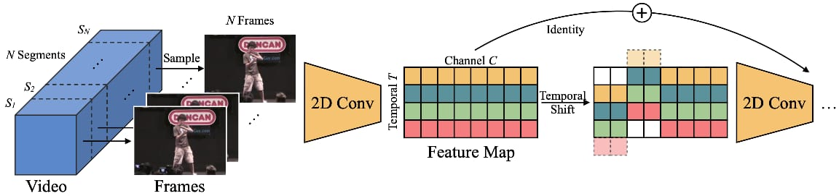
INFERENCE ENGINE - ARCHITECTURE
TSM aka Temporal Shift Module a deep learning approach for efficient video understanding as Inference Engine core.
Implemented in Pytorch to obtain and make use of GPU ability of parallelism (In training process).
Machine Perception & Visual Intelligence Research Group

Slide 14
INFERENCE ENGINE - ARCHITECTURE
Trained on Colab using Tesla T4/K80 GPU
Trained model on two different architectures using TSM i.e., Resnet50 and MobilenetV2
Validation accuracy of 87% on Resnet50 and 83% on Mobilenet.
Trained strategy included disk-resident frame extraction using python-based directory/file parser and OpenCV for automated labelling of dataset (normal vs abnormal).
Machine Perception & Visual Intelligence Research Group

Slide 15
INFERENCE ENGINE - ARCHITECTURE
TSM+Resnet50 ARCHITECTURE
TSM+MobilenetV2 ARCHITECTURE:
23,512,130 params 23.5M having compute complexity of 4.12GMAC or 8.24GFLOPS.
2,226,434 params, 2.2M having compute complexity of 0.32GMAC or 0.64GFLOPS
Machine Perception & Visual Intelligence Research Group

Slide 16
INFERENCE ENGINE- IMPLEMENTATION
INPUT STREAM
PROCESSING FRAMES
INFERENCE
HANDLING STREAMS
DEPLOYMENT
ANOMALY DETECTION
Live camera feed(IP-Address or Video.)
Extracting and Passing input to Model.
Inference in real-time on single stream (7-8fps) and multiple streams.
The multiple streams are handled, simultaneously.
Deployed on NVIDIA Jetson Nano on single stream (17-18 fps) and multiple streams.
Anomaly is detected and the anomaly snippets are stored.
Machine Perception & Visual Intelligence Research Group

Slide 17
PROBLEMS AND CHALLENGES
Details of Model | Limited Resources | Size of Dataset | Training of the Model
Brief information regarding the Model. | Google Colab Timeout session of 12 hours. Link to Google Drive. | Limit of read and write on Google Drive. Multiple Zip files required. | No access of GPU over Google Cloud. Switch to Google Colab.
Machine Perception & Visual Intelligence Research Group

Slide 18
NVIDIA Jetson Nano

Slide 19
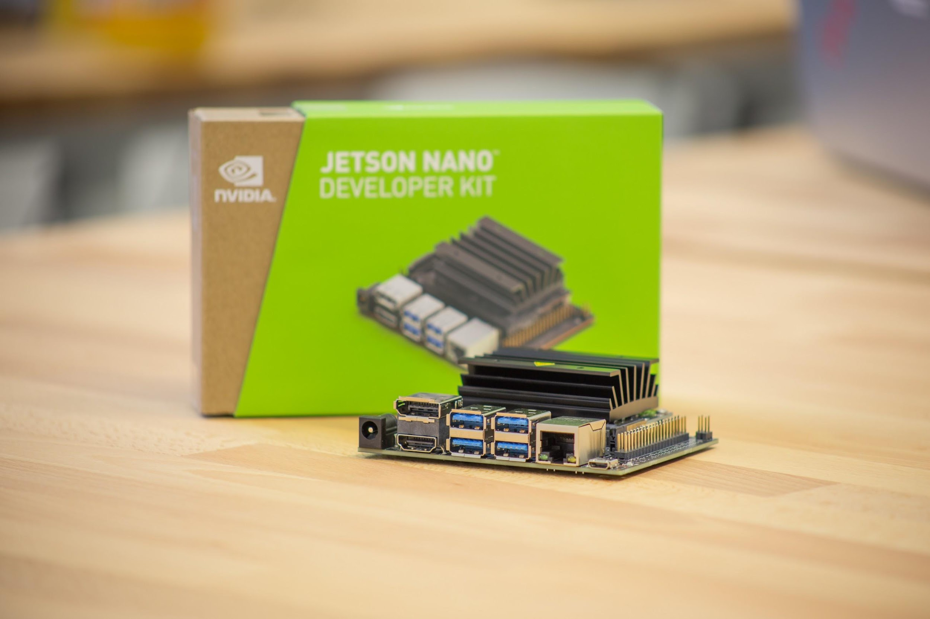
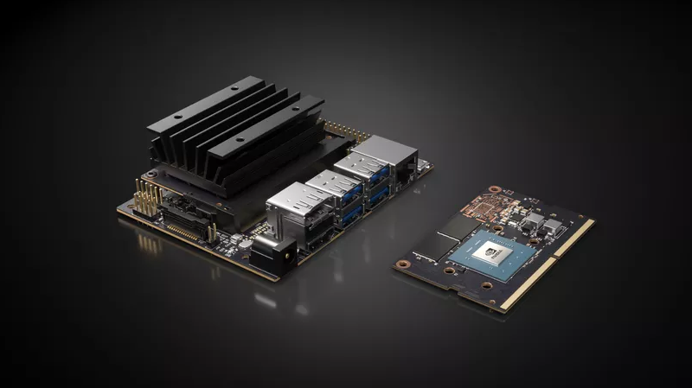
NVIDIA® Jetson Nano™ Developer Kit
A small, powerful computer
Lets you run multiple neural networks in parallel
For applications like image classification, object detection, segmentation, and speech processing
Easy-to-use platform
Runs in as low as 5 watts.
Machine Perception & Visual Intelligence Research Group

Slide 20
NVIDIA® Jetson Nano™ Developer Kit
128 Maxwell Architecture based CUDA Cores
4GB 64-bit LPDDR4 25.6 GB/s Shared RAM with GPU cores.
1 x MIPI CSI-2 DPHY lanes camera interface
10/100/1000BASE-T Ethernet
HDMI port with 1080p UHD output
4 x USB 3.0, 1 x USB 2.0 Micro-B
40 x GPIO, I2C, I2S, SPI, UART, microSD
Video Encoding: 4K @ 30fps
Video Decoding: 4K @ 60fps

Slide 21
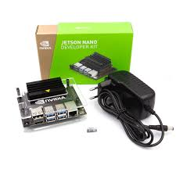
EXPERIENCE WITH JETSON NANO
Installation
Library dependencies

Slide 22
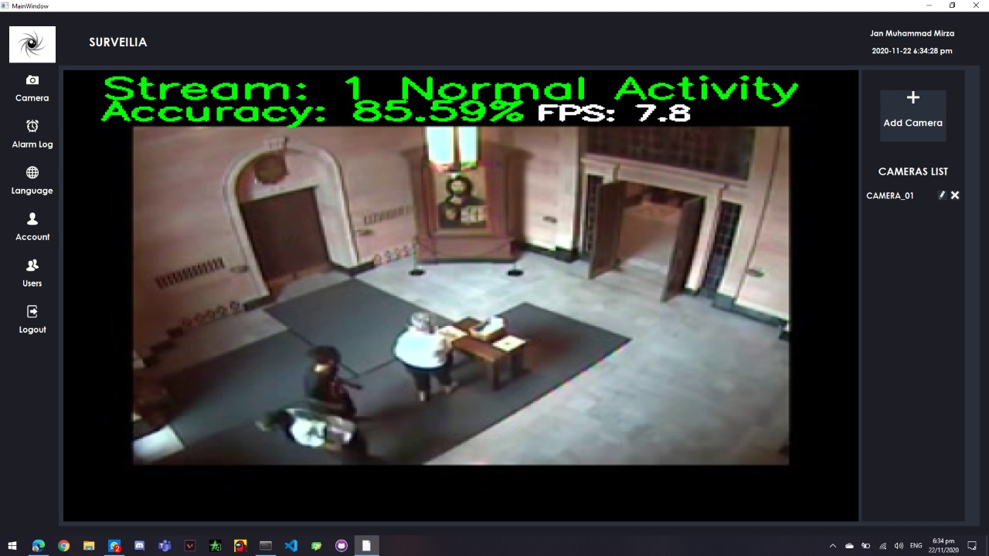
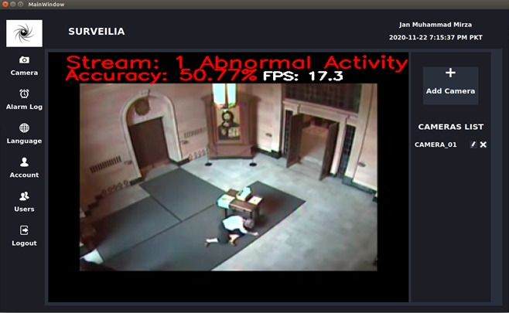
COMPARISON (SINGLE STREAM)
LOW RESOURCE SYSTEM
NVIDIA Jetson Nano
Currently ranges between 7-8 fps
Currently ranges between 17-18 fps

Slide 23
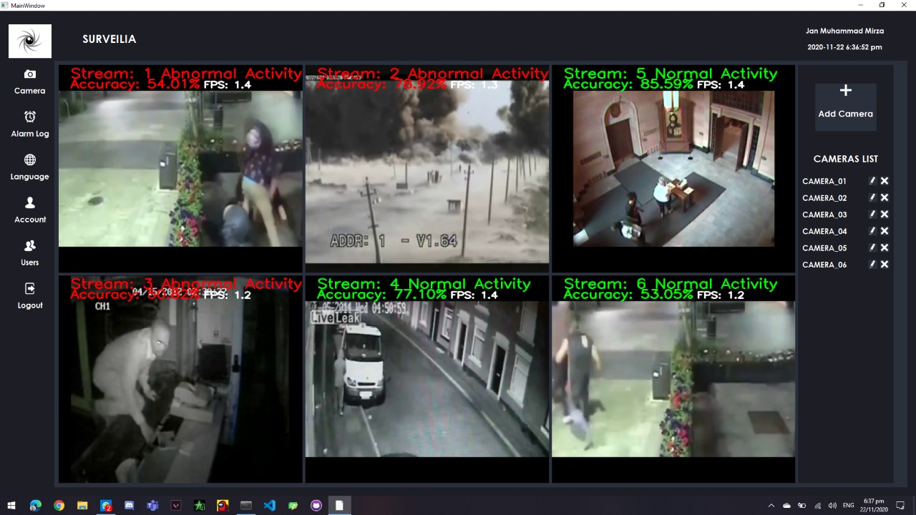
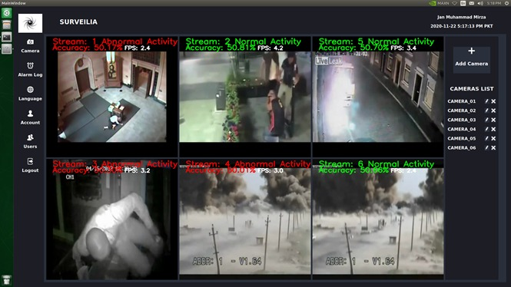
COMPARISON (MULTIPLE STREAMS)
LOW RESOURCE SYSTEM
NVIDIA Jetson Nano
Currently ranges between 1.5-2 fps
Currently ranges between 3-5 fps

Slide 24
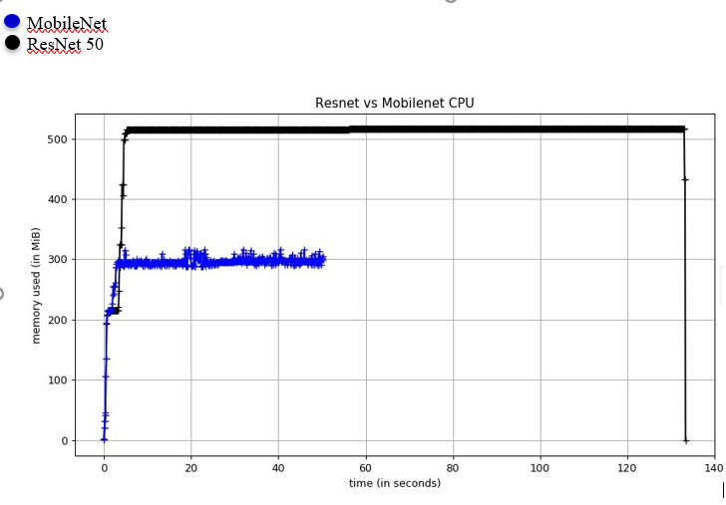
COMPARISON BETWEEN ARCHITECTURE
Inference of two different architectures on low resource
efficient
Machine Perception & Visual Intelligence Research Group

Slide 25
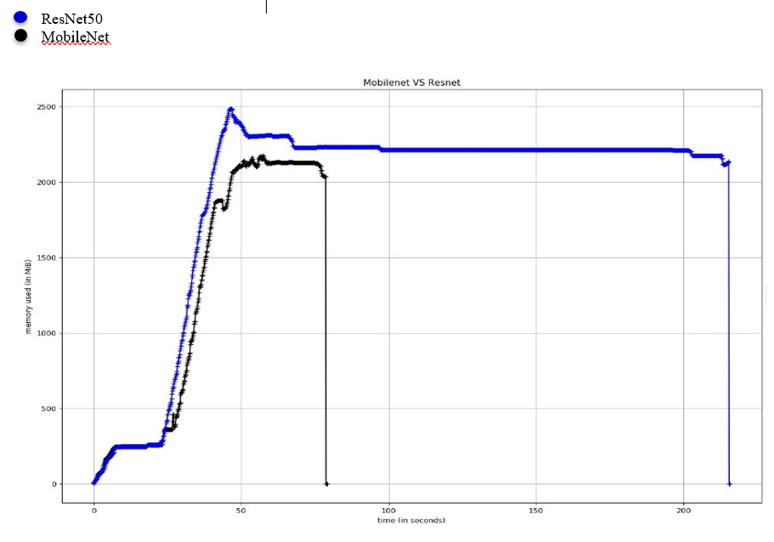
COMPARISON BETWEEN ARCHITECTURE
Inference of two different architectures on NVIDIA Jetson Nano
Machine Perception & Visual Intelligence Research Group

Slide 26
PYTHON UI

Slide 27
PYTHON DESKTOP APPLICATION UI
Implemented using PyQt5
Permits flexibility when dealing with GUI events
Lightweight to load
Responsive to display updated information
Easy and simple language used in the UI for our end user i.e. security guard
Multi-Language
Multiple Versions of Application developed
Contacted the end user for better and final interface
Machine Perception & Visual Intelligence Research Group

Slide 28
PYTHON DESKTOP APPLICATION UI - INTERFACES
Login Form
Main UI
Welcome Screen
Cameras Display Screen
Alarm Log Screen
Account Information Screen
Language Screen
Users information Screen
Users of Application
Admin
Security Guard or Team
Machine Perception & Visual Intelligence Research Group

Slide 29
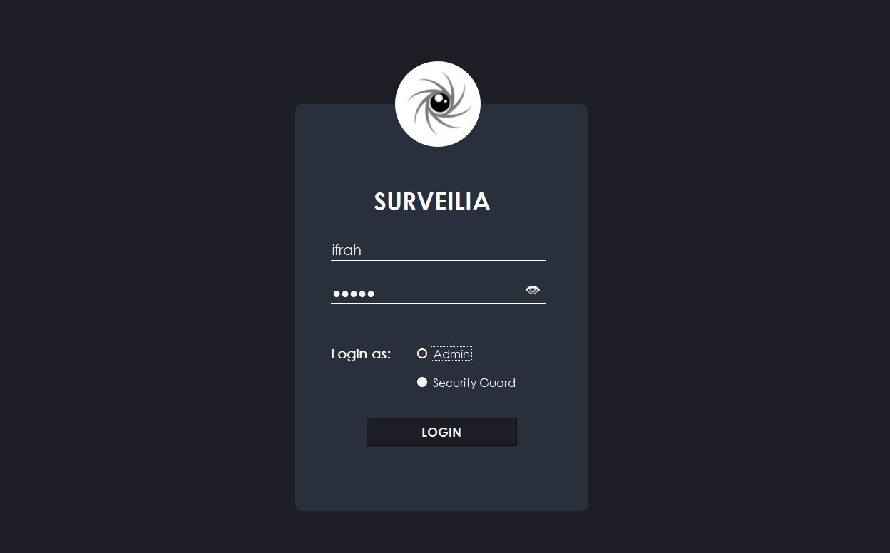
PYTHON DESKTOP APPLICATION UI- INTERFACE
Login Screen
Machine Perception & Visual Intelligence Research Group

Slide 30
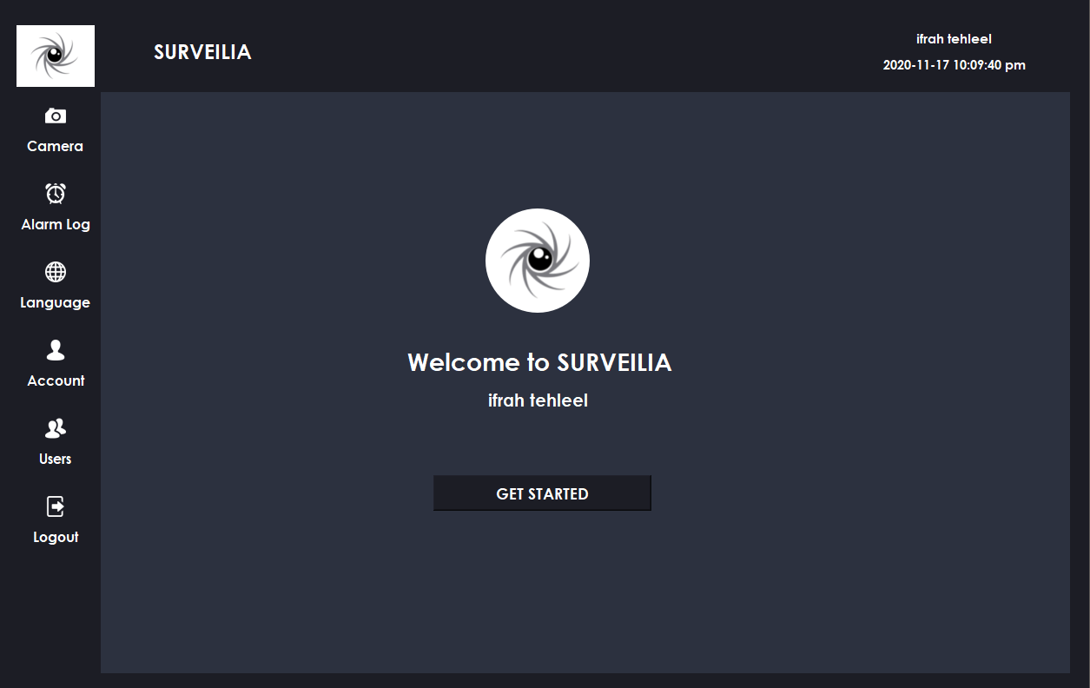
Welcome Screen
Machine Perception & Visual Intelligence Research Group

Slide 31

Supports Multi-language

Slide 32
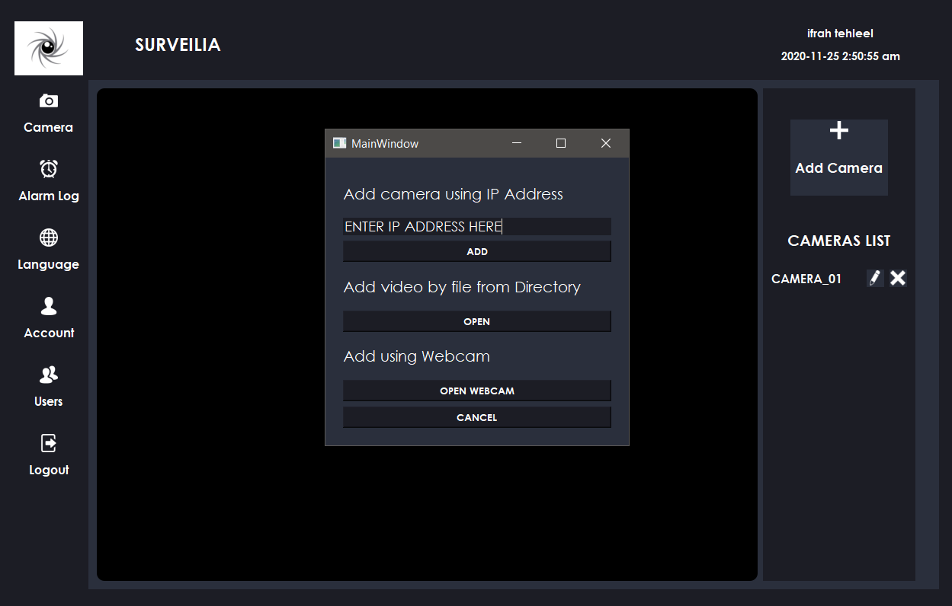
Three Options

Slide 33
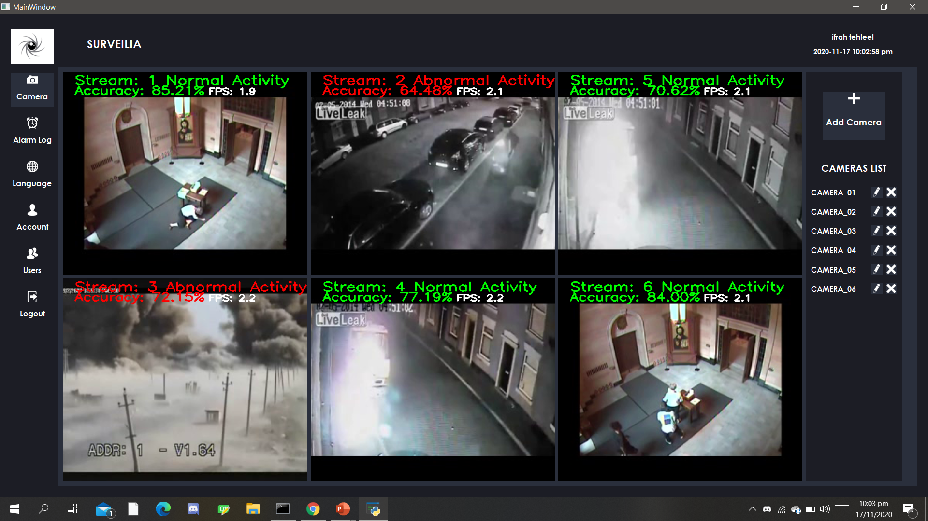
Camera Screen, displaying 6 screens running simultaneously.
Machine Perception & Visual Intelligence Research Group

Slide 34
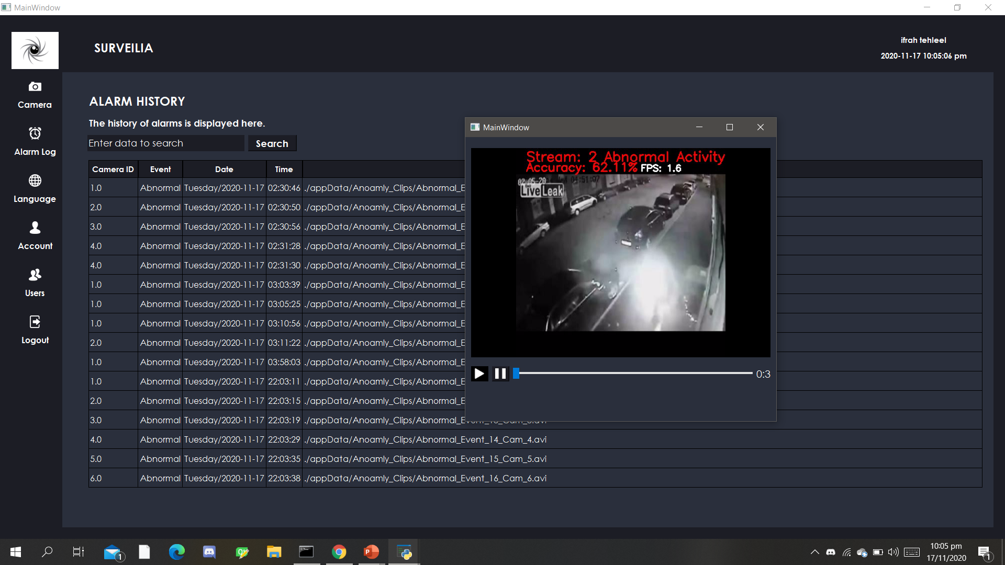
Displaying the saved anomalies
Machine Perception & Visual Intelligence Research Group

Slide 35
FUTURE WORK
Further extensions on this system are as follows:
Multi Class Action Recognition of the Anomaly.
Integration with the City-Wide Surveillance network.
Machine Perception & Visual Intelligence Research Group

Slide 36
ADDITIONAL WORKING
Writing a Journal Research Paper.
Machine Perception & Visual Intelligence Research Group

Slide 37







TOOLS AND TECHNIQUES
Google Colab
PyQt5
Pytorch
GitHub
Machine Perception & Visual Intelligence Research Group

Slide 38
FUNDED BY IGNITE NGIRI
Machine Perception & Visual Intelligence Research Group

Slide 39
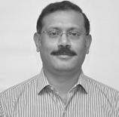
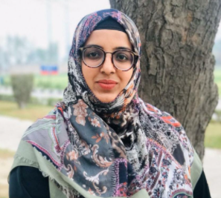
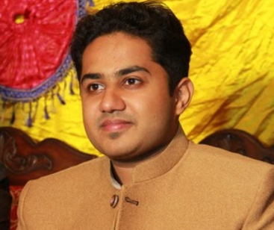
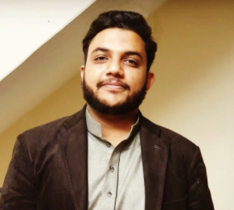
OUR TEAM
Dr. Usama Ijaz Bajwa
Ifrah Tehleel
Nauman Akram
Jan Muhammad Mirza
Supervisor
Group Leader
SP17-BCS-109
Team Member
SP17-BCS-145
Team Member
SP17-BCS-028
Machine Perception & Visual Intelligence Research Group

Slide 40
CONNECT US VIA…
MPVIR
Our Work is cited at Machine Perception & Visual Intelligence Research Group
https://sites.google.com/view/mpvir/projects/surveilia?authuser=0
GITHUB
Find our Work Find our Work at GitHub
https://github.com/IfrahTehleel/Surveilia
Machine Perception & Visual Intelligence Research Group

Slide 41
Thank You!
Do you have any queries?
Machine Perception & Visual Intelligence Research Group

